Slide 1
Monetary Policy Report
January 2020
    Annex: Other forecasters’ expectations

Slide 2
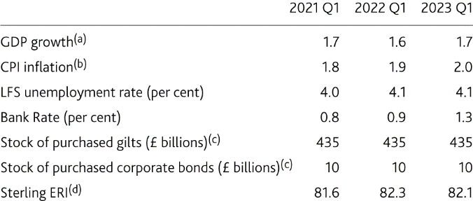
  Table 1 Averages of other forecasters’ central projections
Sources: Projections of outside forecasters as of 17 January 2020.
(a) Four-quarter percentage change.
(b) Twelve-month rate.
(c) Original purchase value. Purchased via the creation of central bank reserves.
(d) Index: January 2005 = 100.

Slide 3
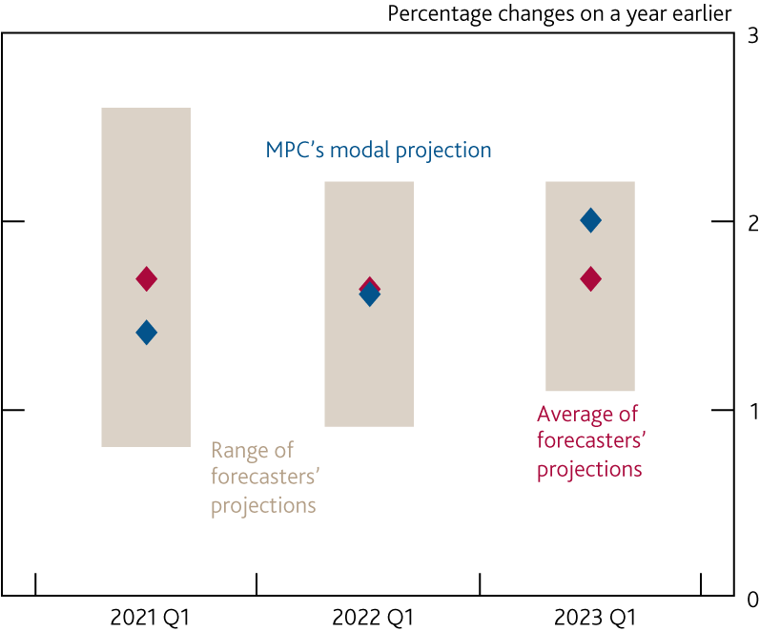
  Chart A On average, forecasters’ central projections for
  GDP growth are a little below the MPC’s in the medium term
    Projections for GDP
Source: Projections of outside forecasters as of 17 January 2020.

Slide 4
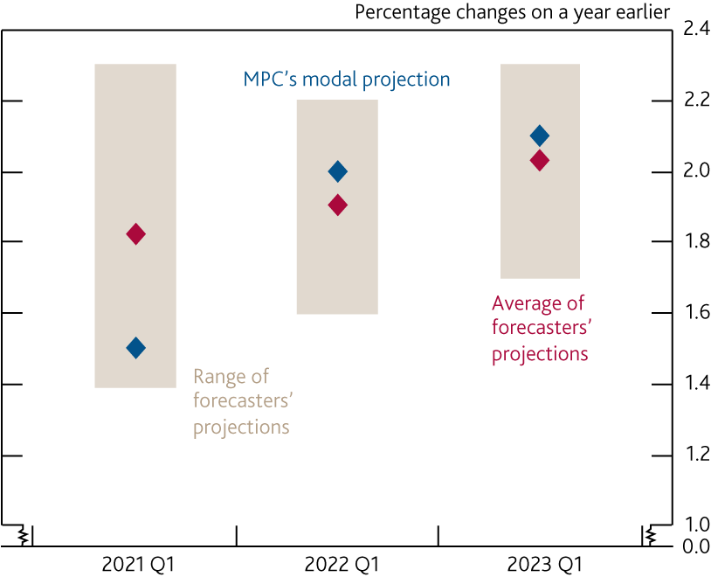
  Chart B Forecasters project inflation to return gradually to the MPC’s target
    Projections for CPI inflation
Source: Projections of outside forecasters as of 17 January 2020.

Slide 5
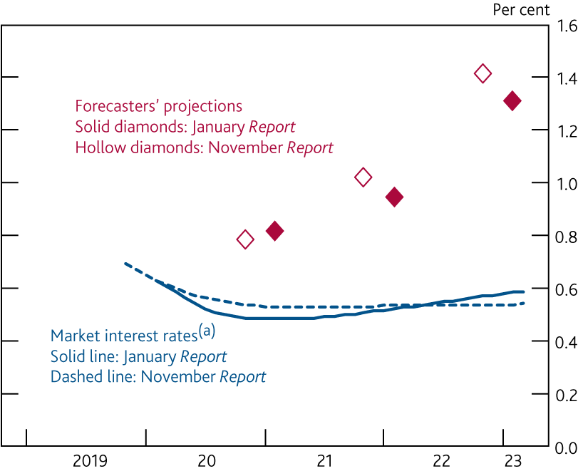
  Chart C Forecasters’ average central projection for Bank Rate remains well above market interest rates
    Market interest rates and averages of forecasters’ central projections for Bank Rate
Sources: Bloomberg Finance L.P. and projections of outside forecasters as of 17 January 2020 and 25 October 2019.
(a) Estimated using instantaneous forward overnight index swap rates in the 15 working days to 22 January 2020 and 30 October 2019 respectively.

